Slide 1

IoT Smart Lamp Presentation
By Robert Solomon
GitHub: https://github.com/EazyRob97

Slide 2

WHY SMARTLAMP!

Slide 3
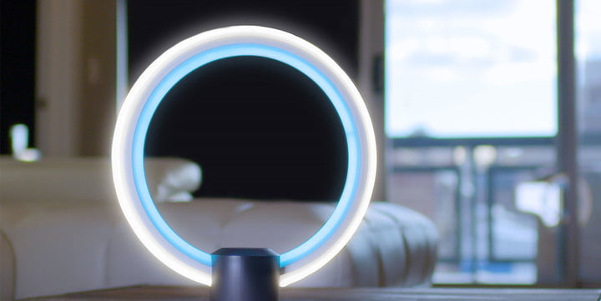

Slide 4


Slide 5
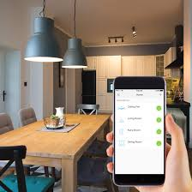
WHY SMARTLAMP!
CAN BE CONTROLLED FROM ANYWHERE

Slide 6

SOME CAN HELP YOU SLEEP BETTER

Slide 7
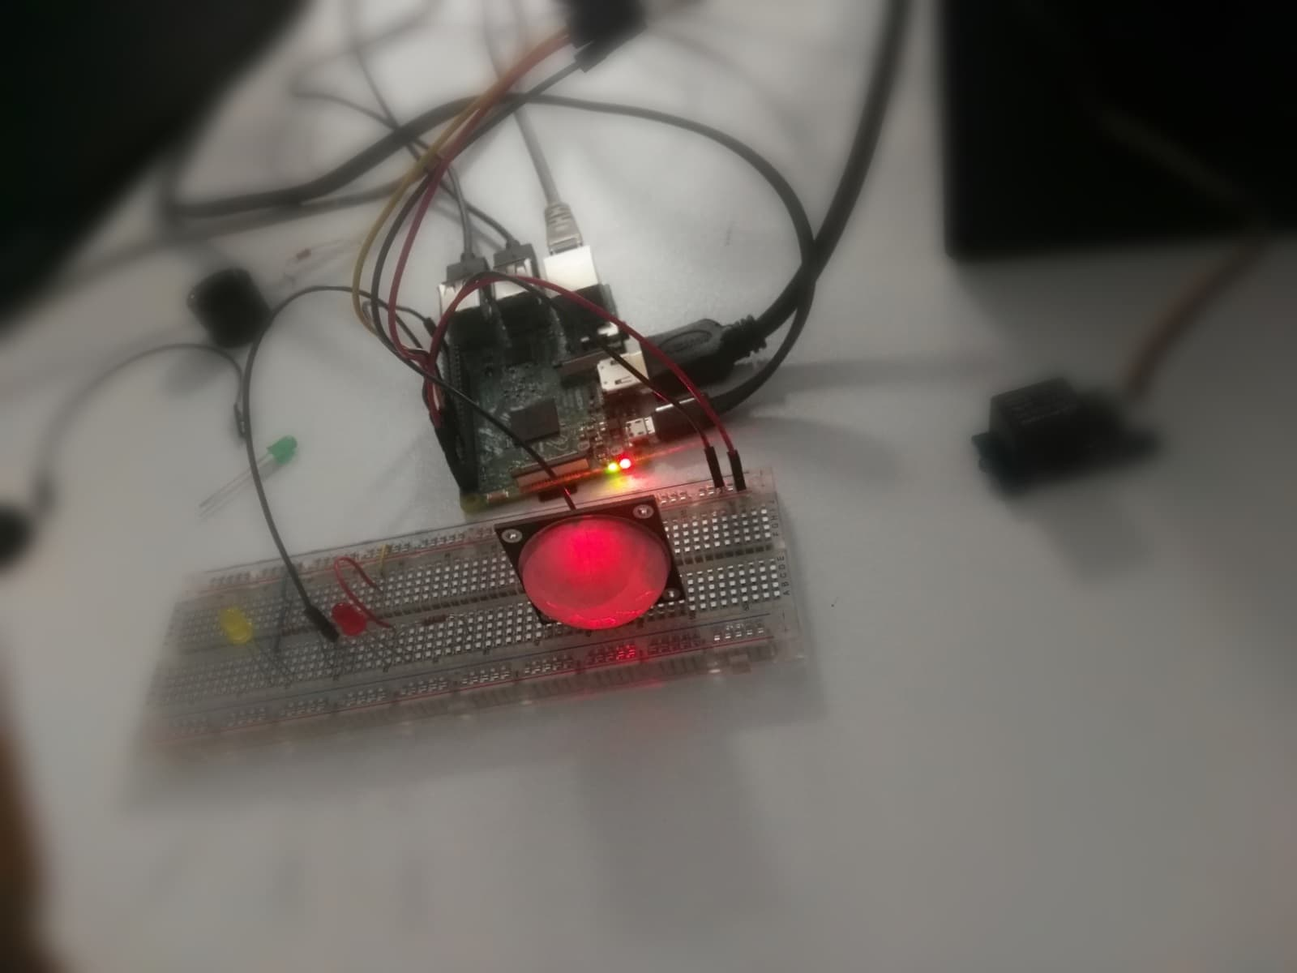
Design/Technology Used!
Smartphone & App
SD Card
Raspberry Pi3
Lamp
5V Relay
2x Resistors (Optional)
PIR Sensor
Blynk Application
Breadboard (Optional)
2x LED’s (Optional)

Slide 8
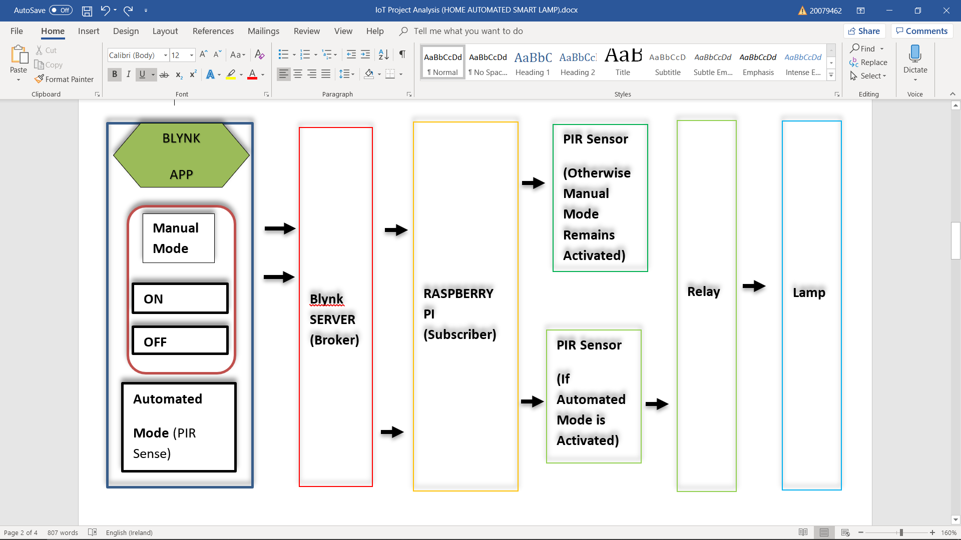
Functionality (HOW IT WORKS!)

Slide 9
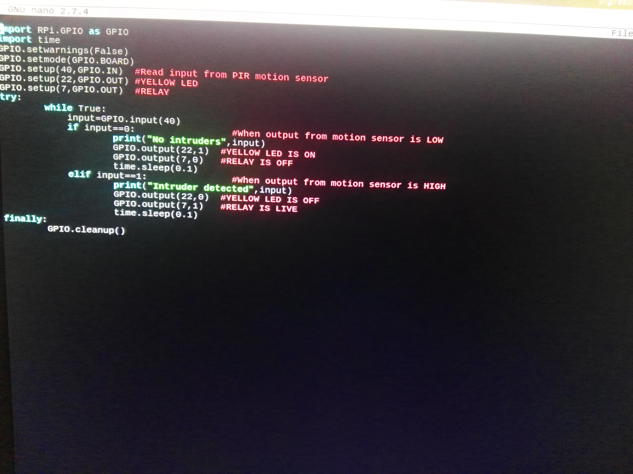
Python Code for PIR Sensor

Slide 10
Python code
Sensor reads in Motion Data
While process is true, turn on Relay
Python Based Program

Slide 11
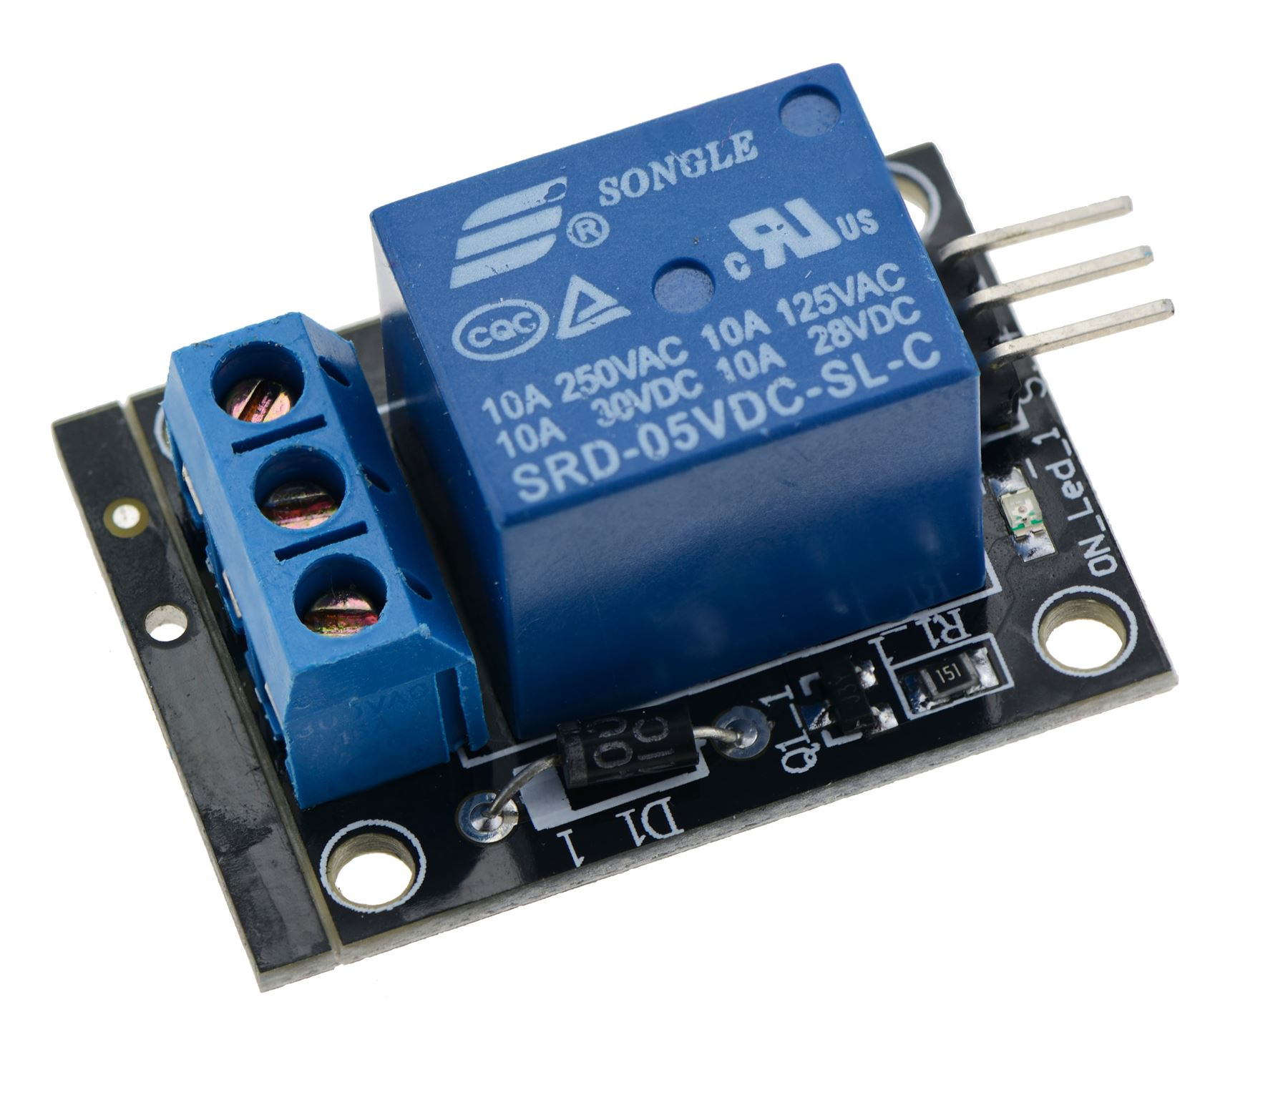
RELAY
Electrically Operated Switch
Many operate using an electromagnetic switch
Other use solid-state relays

Slide 12
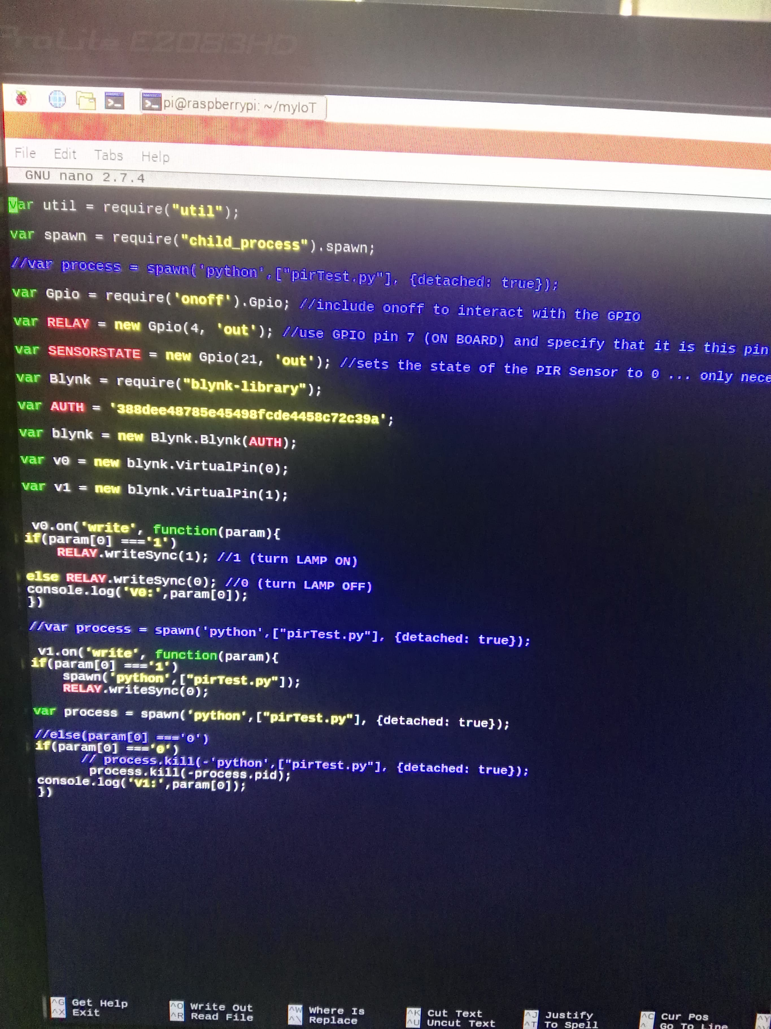
Node.js Code for Relay Switch

Slide 13
Node.js Code for Relay Switch & python script launch
ON/OFF controls the Relay
Activate/Deactivate controls the PIR Sensor
Node.js Based Program
Running Child process module to launch Python Script (PIR Sensor)

Slide 14
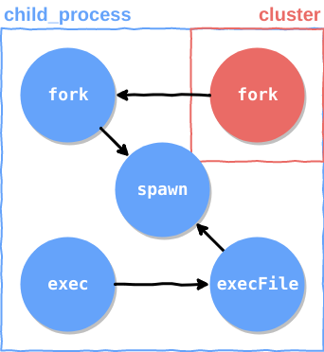
Node.js CHILD PROCESS
Process created by another process
Allows for ease communication between two different programs
Pre-built-in Node.js module

Slide 15
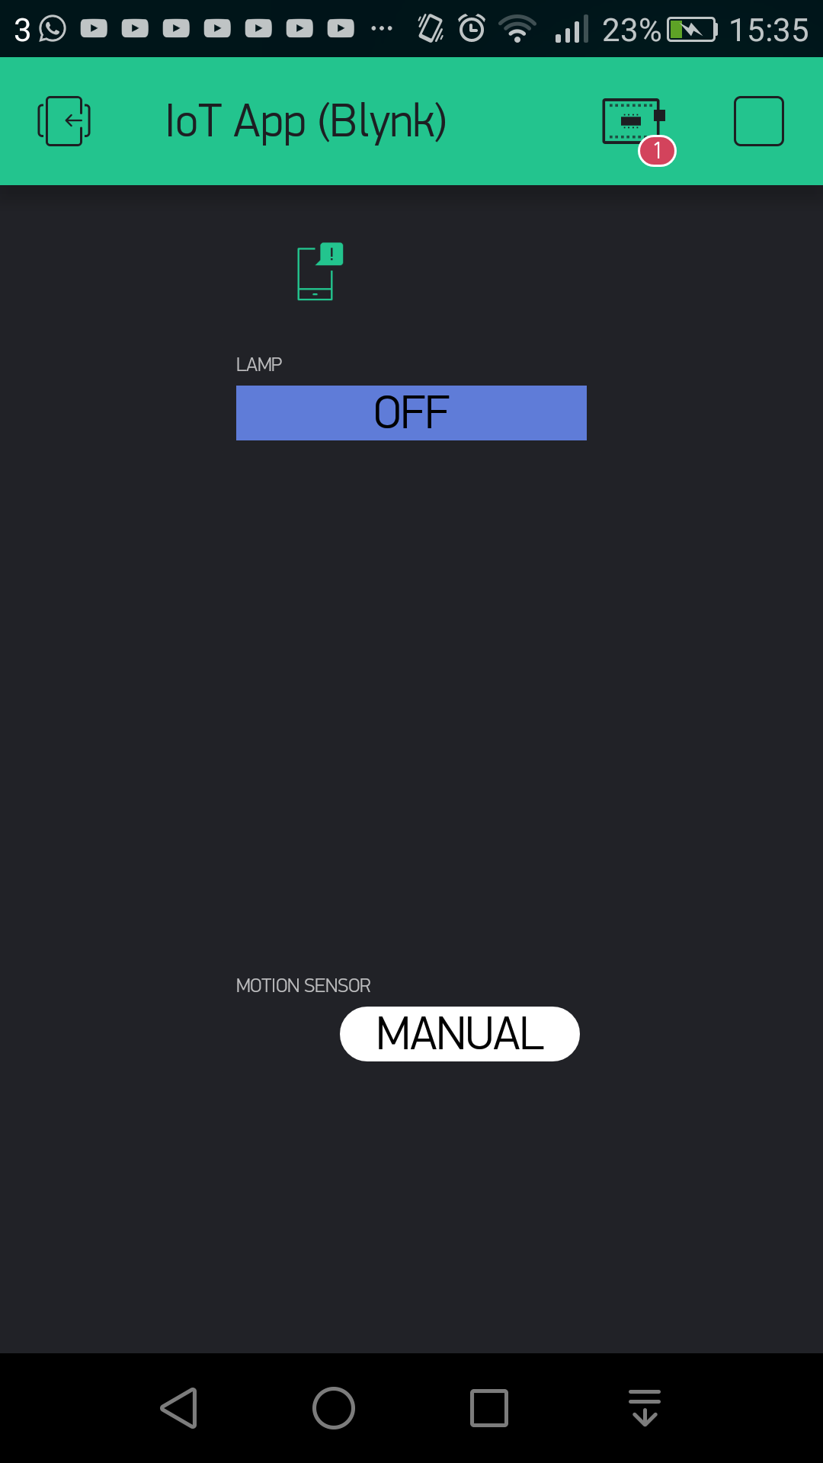
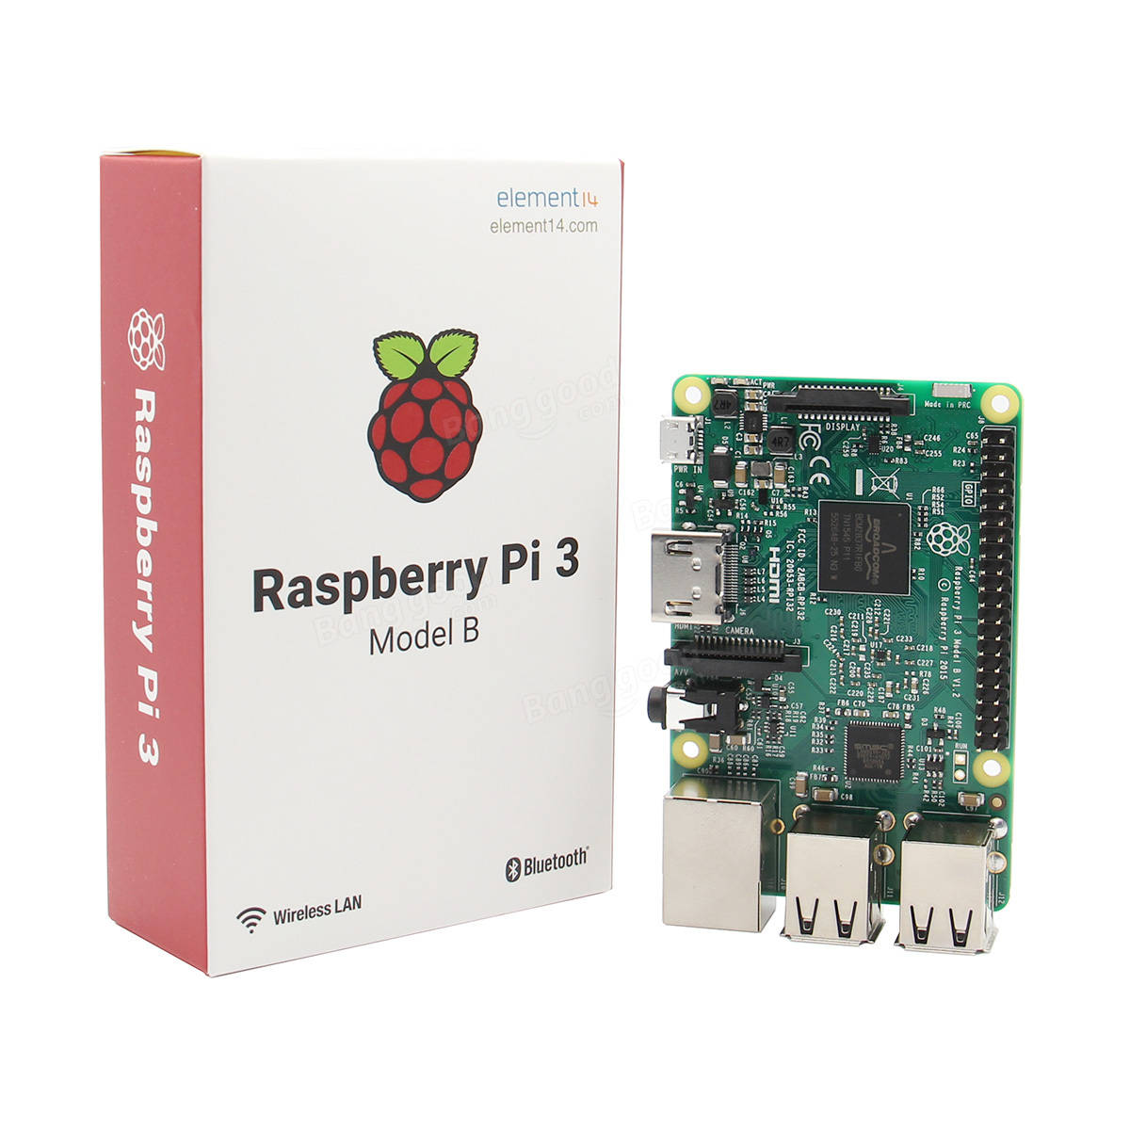
MaJOR COMPONENTS IN USE
Blynk Application
Raspberry Pi

Slide 16


Challenges Encountered
Establishing communication between Node.js & Python Scripts
Disabling the ON/OFF Button when PIR Sensor is active

Slide 17

Things I Learned!
Using python & node.js
Patience
Critical Thinking
Source Control

Slide 18
Summary (Future Improvements)
Add an option to use voice recognition to turn on/off the lamp (for satisfaction & efficient use)
Research into adding more Sensors (for more secure features)

Slide 19

Thank You!

